Slide 1
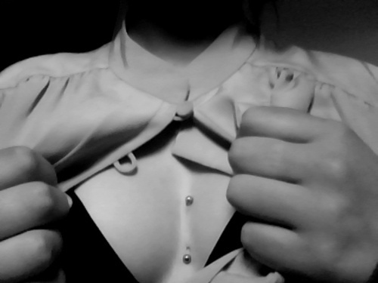
PIERCING ☺

Slide 2
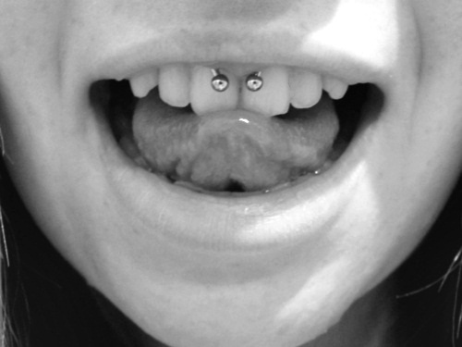
Definition
Body piercing, a form of body modification, is the practice of puncturing or cutting a part of the human body, creating an opening in which jewellery may be worn. The word piercing can refer to the act or practice of body piercing, or to an opening in the body created by this act or practice. Although the history of body piercing is obscured by popular misinformation and by a lack of scholarly reference, ample evidence exists to document that it has been practiced in various forms by both sexes since ancient times throughout the world.

Slide 3
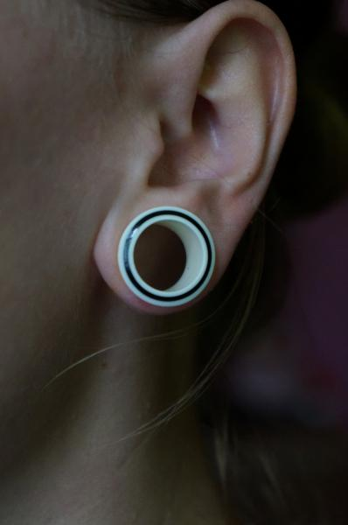
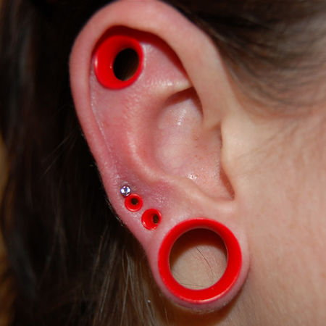
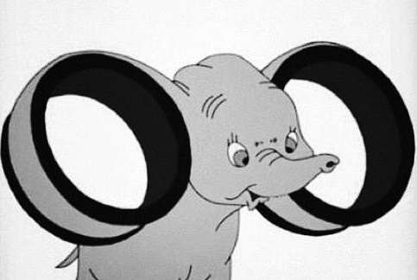
Tunnels
Tunnels are advanced holes in different areas of the body (usually the ear pinna). Their size varies from as low as 1.6 mm for substantially any size.

Slide 4
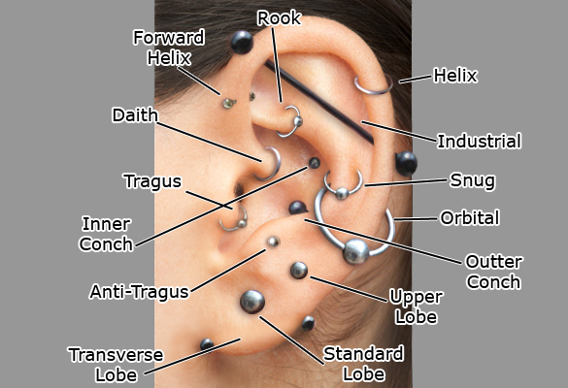
Types ☺
Ear:
Standard Lobe
Tunnels
Tragus
Vertical Tragus
Anti Tragus
Conch
Industrial
Forward Helix
Helix
Horizontal Lobe
Daith
Rook

Slide 5
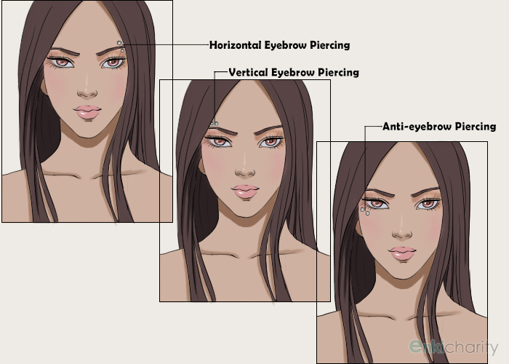
Eyebrow:
Standard Eyebrow
Horizontal Eyebrow
Anti Eyebrow

Slide 6
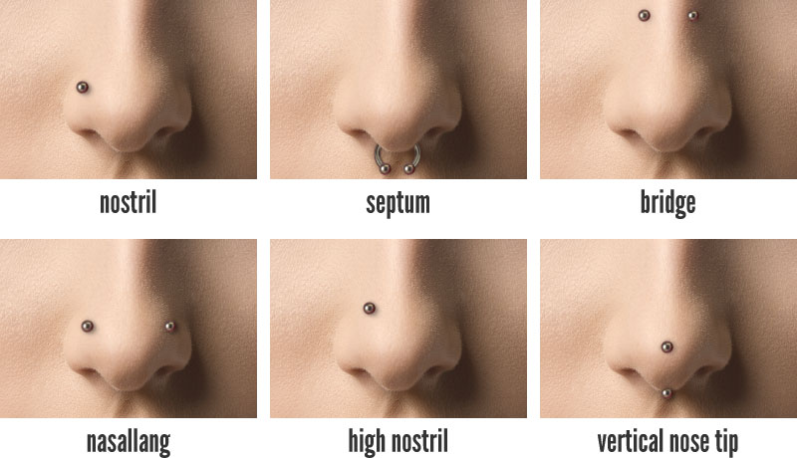
Nose:
Standard Nostril
Septum
Bridge
Vertical Bridge
Nasallang

Slide 7
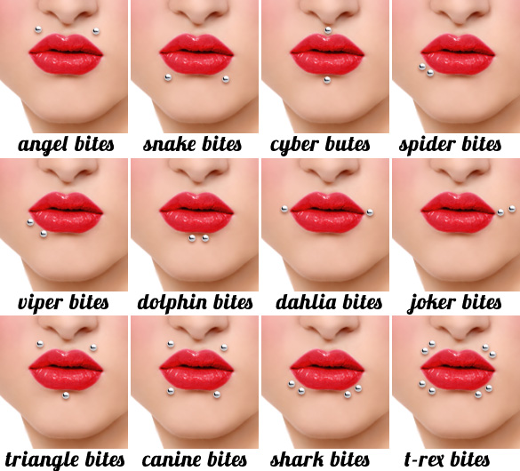
Lips:
Standard Labret
Lip Ring
Madonna/Monroe
Horizontal Lips
Lowbrets

Slide 8
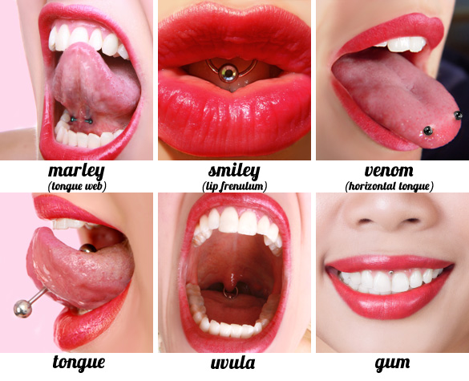
Tongue:
Standard Tongue
Double Tongue
Horizontal Tongue
Tongue Web
Venom
Smiley
Tongue Web
Uvula

Slide 9
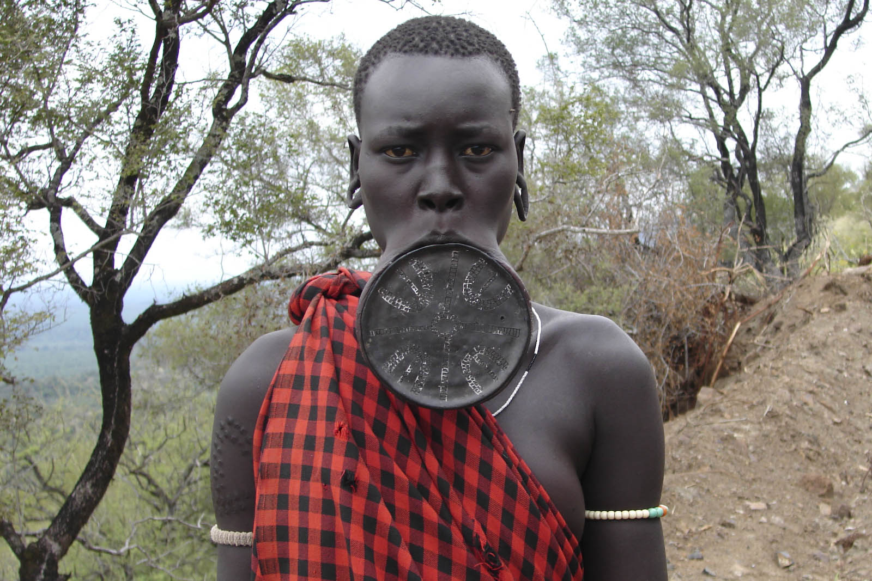
The End ☺

