Slide 1
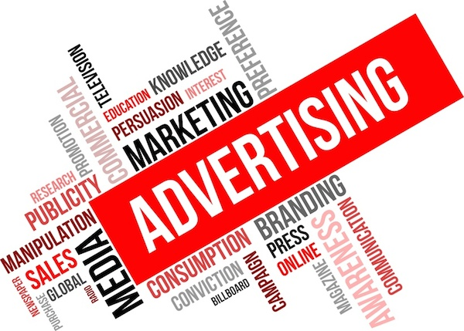
Dictionary
for technician of advertising organisation

Slide 2
What do you know, what’s a advert? No? So we’re going to explaine it for you!
Every companies do market research. They ask for advertising agency to make their marketing plan, advert or comercials. It’s commissioning advertising

Slide 3
Marketing and advertising - basics
market research – badanie rynku
marketing plan - plan marketingowy
the company – firma
advertisement (advert, ad) – ogłoszenie reklamowe
to advertise – reklamować
advertising agency – agencja reklamowa
comercials (on TV) – reklamy telewizyjne
commissioning advertising – reklama na zamówienie

Slide 4
Brand manager manages brand. He decidedes about everything for brand. Director of marketing works with brand manager. He accepts his ideas and projects. Marketing assistant helps brand manager and director of marketing.
Head of PR works with media, he talks about company and creates its positive image.
Ad agency makes ads for its clients.
Art director makes artistic party of ad with computer graphyics.
Copywriter creates slogans.

Slide 5
Job advertisements – ogłoszenia o pracę
brand manager – menedżer marki
director of marketing – dyrektor ds. marketingu
head of PR – szef działu PR
public relations (PR) – relacje z mediami
marketing assistant – asystent ds. marketingu
ad agency – agencja reklamowa
art director – dyrektor artystyczny
copywriter – osoba pisząca hasła i slogany reklamowe
graphic designer – grafik

Slide 6
Brand name is what a brand is called.
Brand awarness is how much people are aware of a brand.
Brand identity is what company wants people to think about a brand.
Brand image is what people think about brand.
Off-brand is when a product doesn’t fit the company brand.
Brand equity is the value that a brand adds to a product or service.
Brand loyalty is when people like a brand.
Branding is when product or service is associated with brand.
Brand extension is when an existing brand is used to supprot a new range of products.
Derived brand is when a component od product becomes a brand in its own right.

Slide 7
Brand – marka
brand awareness – świadomość marki
brand equity (what brand gives you?)– wartość marki
brand extension – rozszerzenie marki
brand identity – identyfikacja marki
brand image – wizerunek marki
brand loyalty – lojalność marki
brand name – nazwa marki
branding – kiedy dany produkt jest związany z marką
derived brand – zasięg marki
off-brand – poza marką, wyłączony z marki

